Slide 1
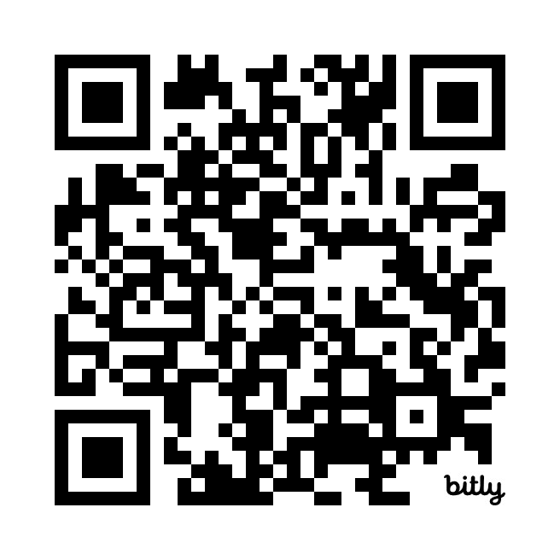

The Unified Modeling Language Quiz
https://bit.ly/3TW7PIb

